Slide 1
Melody-Conditioned Lyrics Generation Using Large Language Models
Wenhao Xu, Owen Jia
Supervised by Prof. Hongyi Wen

Slide 2
Agenda
Topic Insights
Approach Showcase
Contribution
Discussion
Collaboration Plan

Slide 3
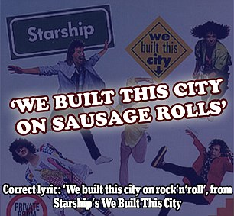
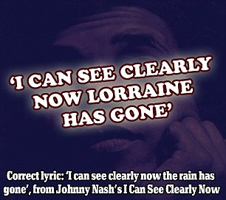
Topic: Misheard Lyrics (空耳 konger)
Sometimes, our ears play tricks on us, turning familiar songs into amusing and often hilarious reinterpretations. Misheard lyrics or "Konger" is the art of mishearing and substituting lyrics, giving a twist to the original song.
Image source

Slide 4
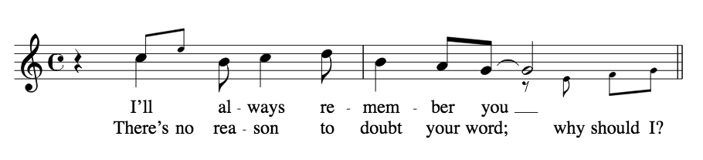
Topic: Melody-Lyrics Alignment (合韵 heyun)
Melody is the combination of note and rhythm, the series of pitch and duration.
Crafting lyrics plays an essential role in the songwriting process. Within the domain of lyrics generation, researchers have long dedicated to incorporating various conditions, like melody, genre, topic, as guidance for enhancing the expressiveness and alignment with the music. We focus on a new approach in the melody-conditioned lyrics generation which would explore the usage of LLMs with melody-lyrics alignment.

Slide 5
Topic - Models In Related Work
Pros:
Melody-conditioned Lyrics Generation
Seq2Seq Model
RNN (Watanabe, 2018)
LSTM (Xu, 2019)
SeqGAN (Chen, 2020)
Transformer
Prompt-less Fine-tuning
BERT, Google CANINE (Zhang, 2023)
Tuning-free Prompting
GPT Family (GPT-2, GPT-3.5, GPT-4)
Creative Freedom
Flexibility on Music Patterns
Easy to be Fine-tuned
Cons:
Latent Correlation unlearned
Overfitting for limited dataset
Lack of Context, struggle with long-term dependencies of melody input

Slide 6
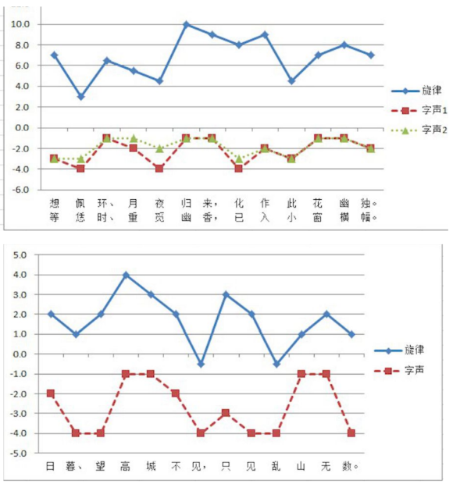
Topic - Measurements In Related Work
Melody-lyrics Alignment Measurement
Rhythm Alignment
In one segment or line, #notes = #syllables (Watanabe, 2018)
Duration-stress Rule (Tian, 2023)
{longer note: 1, shorter note: 0} —> {1: stressed syllables, 0: unstressed syllables}.
Pitch Alignment (Merrill, 2012)
Corresponding increase or decrease between melody’s pitch contour and lyrics’ one.
Topic-Related Text Quality (Tian, 2023)
BLEU / Test-set Perplexity (PPL)
Pitch Alignment Case Study on Chinese traditional songs during Song Dynasty

Slide 7
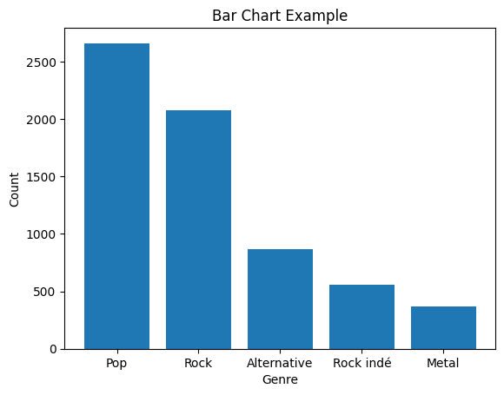
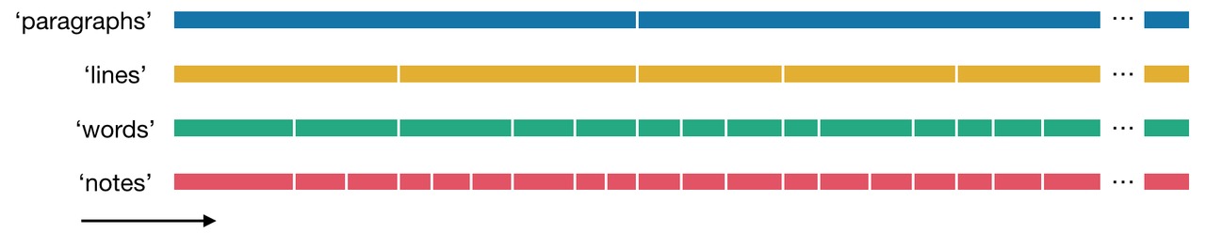
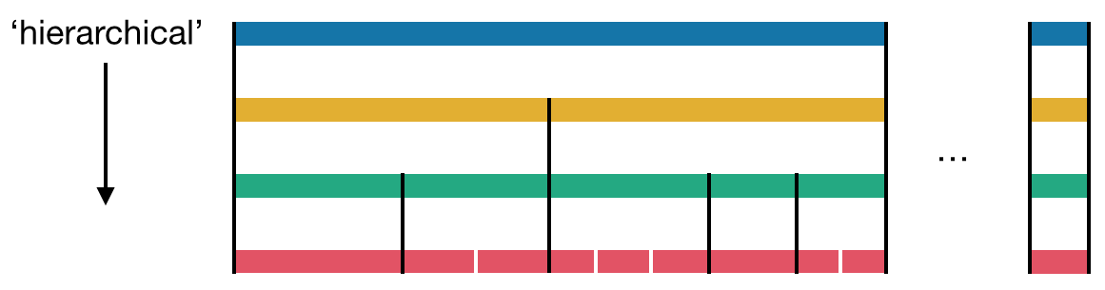
Approach - DALI Dataset
DALI: a large Dataset of synchronised Audio, LyrIcs and vocal notes, containing 5000+ songs.
DALI Dataset

Slide 8
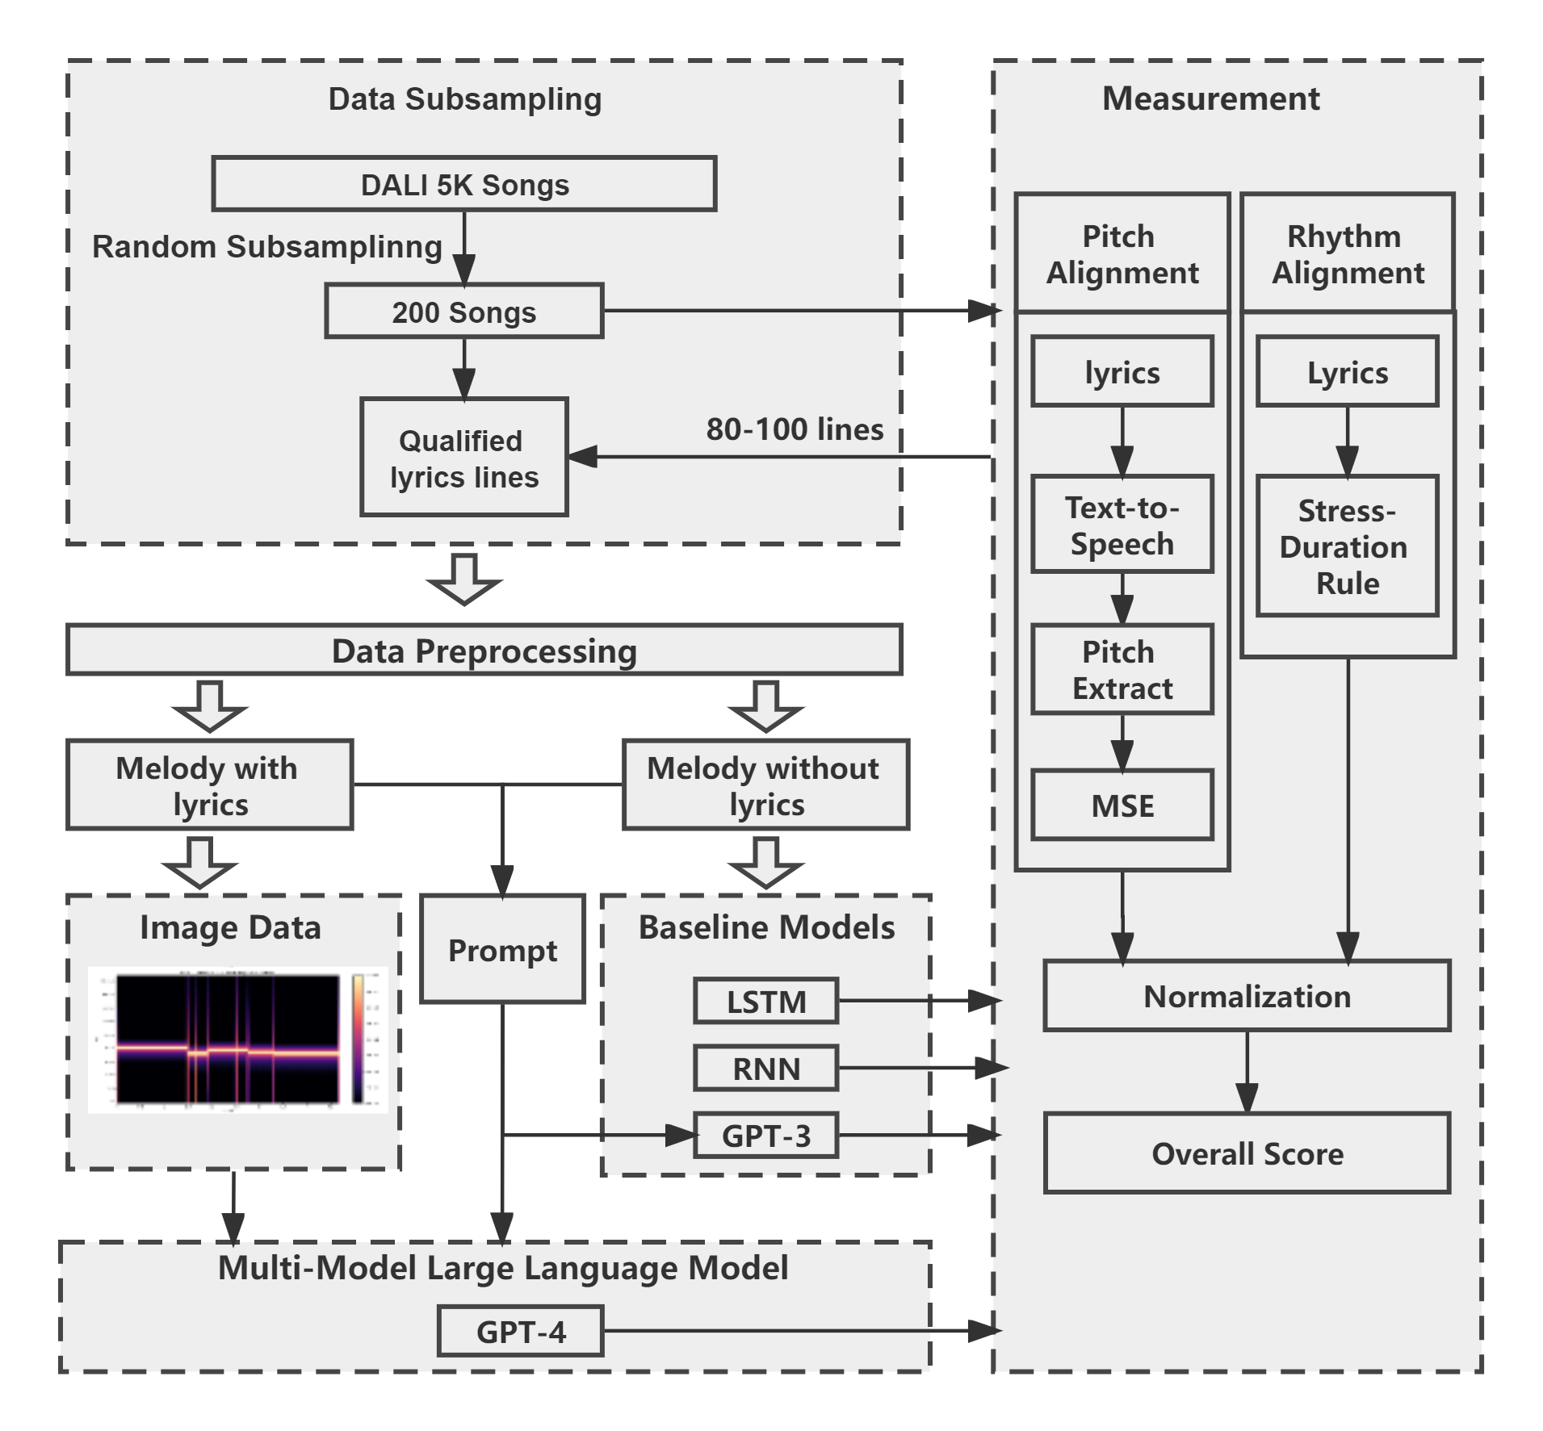
Approach - Architecture
Data Preparation
Measurement
Rhythm Alignment
Pitch Alignment
Baseline Models
LSTM
RNN
Text-input LLM: GPT-3
Multi-Model LLM

Slide 9
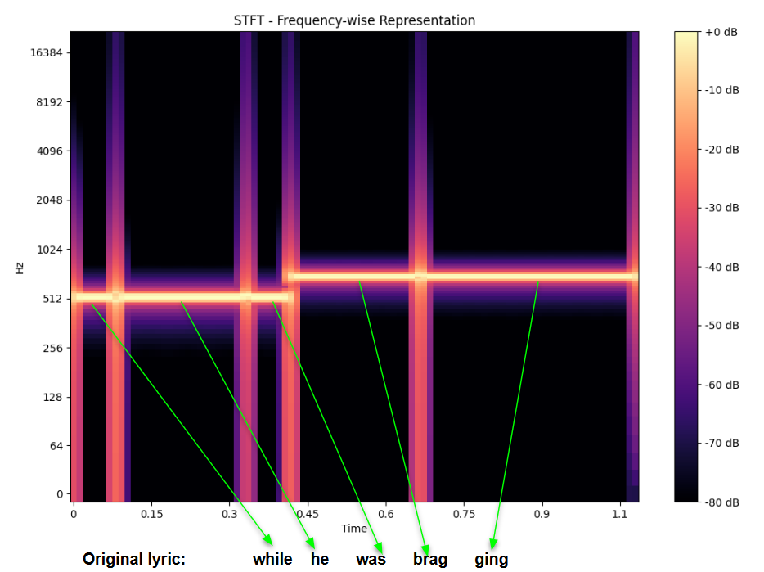
Approach - Novelty in Multi-Model LLM

Slide 10
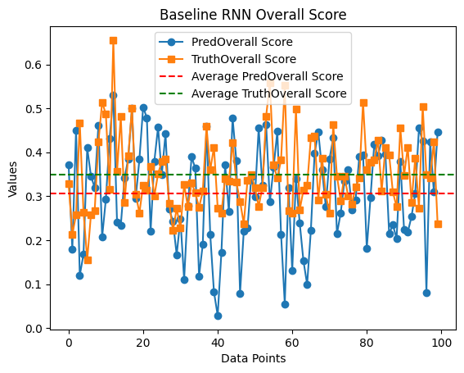
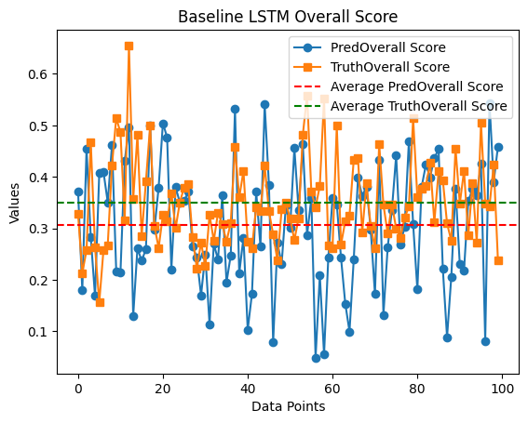
Contribution - Performance

Slide 11
Discussion - Future Work

Slide 12
Collaboration Plan

